Slide 1
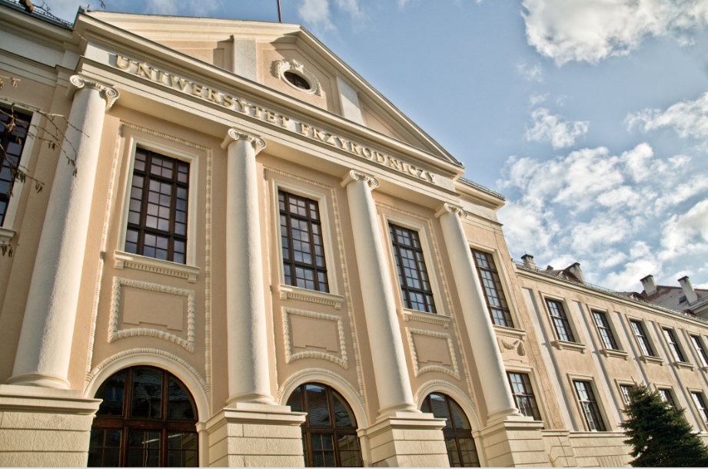
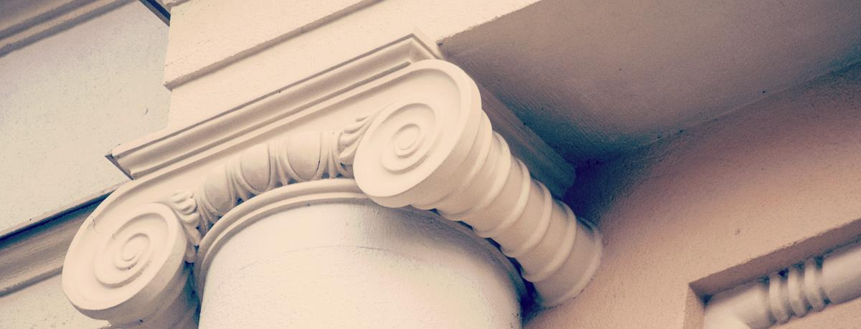
Tytuł prezentacji

Slide 2
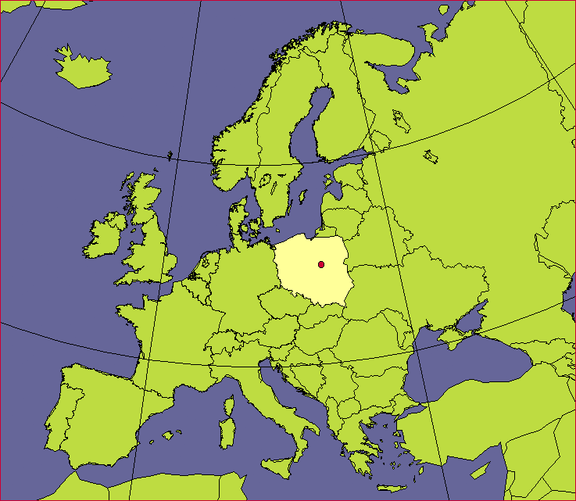
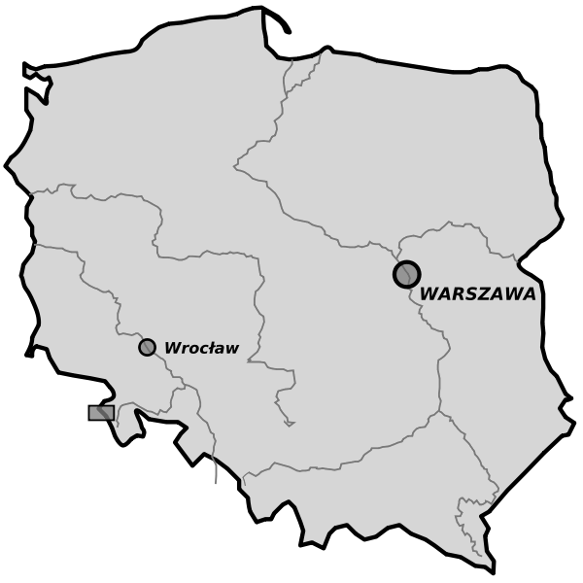
EUROPE
POLAND
WROCLAW UNIVERSITY OF ENVIRONMENTAL AND LIFE SCIENCES

Slide 3

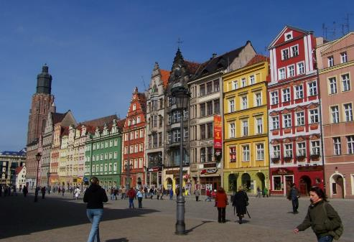
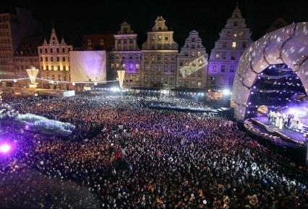
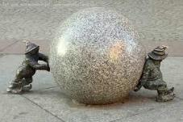
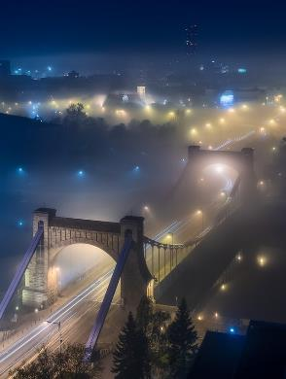
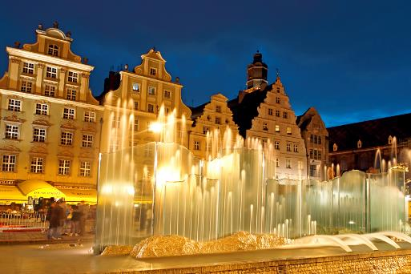
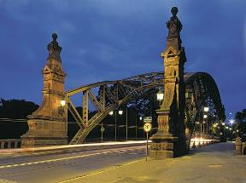
WROCŁAW
- THE MEETING PLACE
wikipedia.org
elaba.pl
sokol.net.pl
Jarek Ciuruś Fotografia
esslli2012.pl

Slide 4
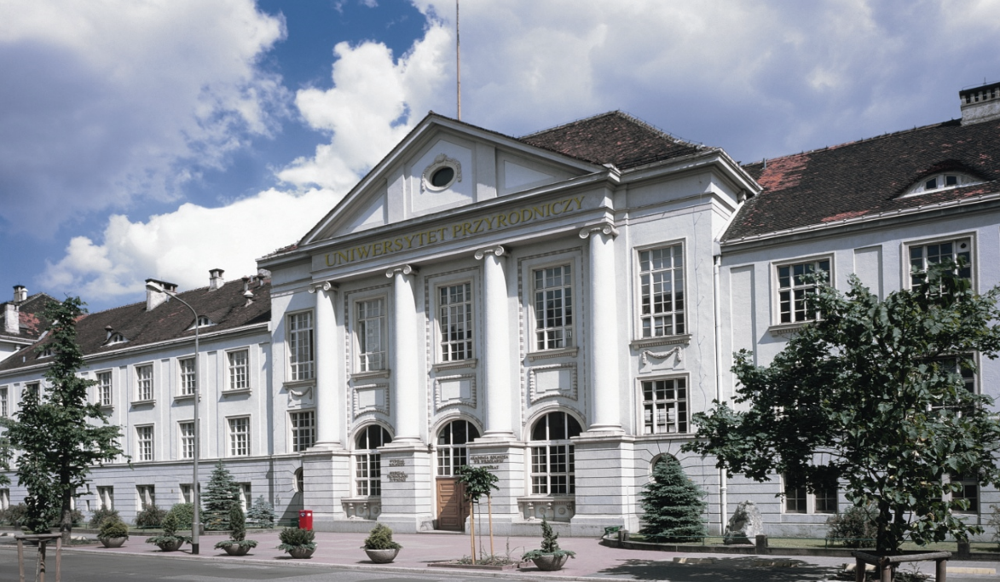
www.upwr.wroc.pl

Slide 5
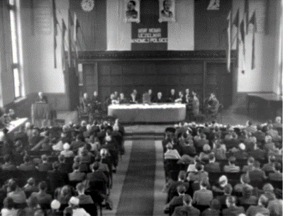
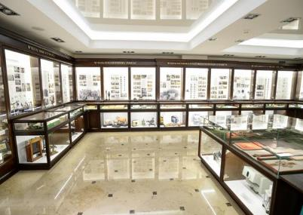
HISTORY
1945 – the decree of the State National Council which created the University
and Polytechnic with the Faculty of Veterinary Medicine and the Faculty of Agriculture
1951 – these two faculties were incorporated in the newly
opened Higher School of Agriculture
1972 – Higher School of Agriculture was renamed
as the Agricultural University of Wrocław
2006 – renamed as
WROCŁAW UNIVERSITY
OF ENVIRONMENTAL AND LIFE SCIENCES

Slide 6
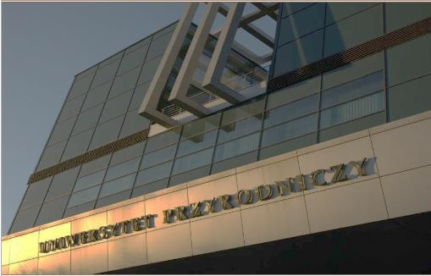
At the beginning of its activity the University employed only 36 scientific and 159 administrative staff members
TODAY
Wroclaw University of Environmental and Life Sciences
employs 1660 people including:
270 professors
470 other academic teachers
The number of students - 8 000
There are:
6 Faculties, 39 Departments and Institutes,
28 fields of study, 49 specialities,
16 post-graduate courses

Slide 7
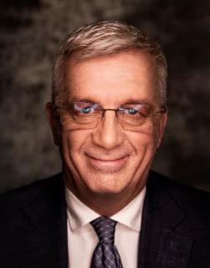
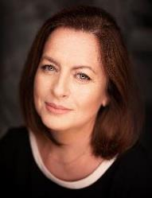
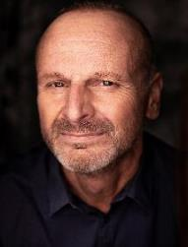
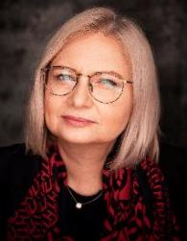
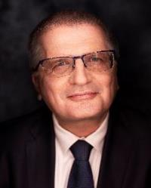
UNIVERSITY AUTHORITIES
2020-2024 TERM
RECTOR
Prof. dr hab. inż. JAROSŁAW BOSY
Prof. dr hab. inż.
Aneta Wojdyło
Vice-Rector
for Science
Prof. dr hab. inż. Damian Knecht
Vice-Rector
for Student Affairs and Education
Prof. dr hab. inż.
Anna Chełmońska-Soyta
Vice-Rector
for Internationalization
Prof. dr hab. inż.
Adam Szewczuk
Vice-Rector
for University Organisation and Development

Slide 8
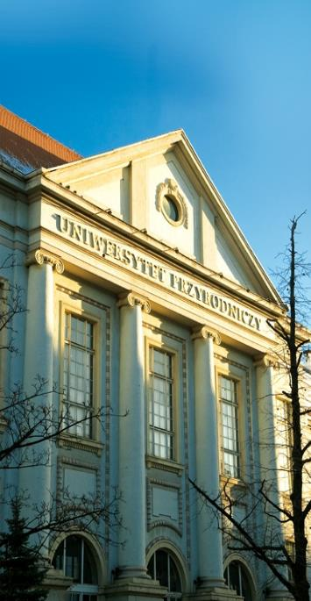
FACULTIES
Biology and Animal Science
Biotechnology and Food Science
Environmental Engineering and Geodesy
Life Sciences and Technology
Spatial Management and Landscape Architecture
Veterinary Medicine

Slide 9

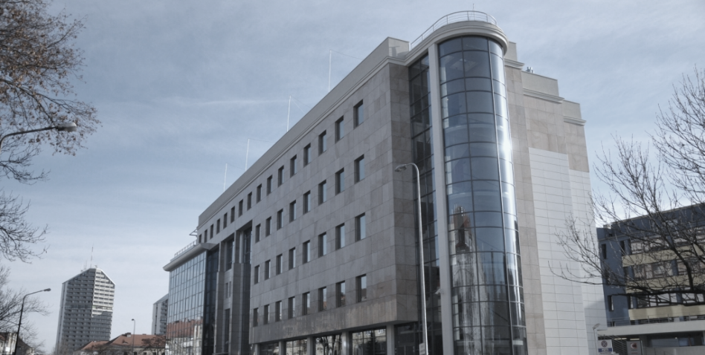
THE FACULTY OF ENVIRONMENTAL ENGINEERING
AND GEODESY
Grunwaldzka str. 55, 50- 357 Wrocław, Poland
phone +48 71 320 15 58
www.wiksig.upwr.edu.pl

Slide 10

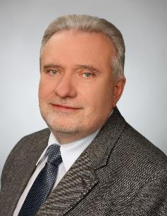
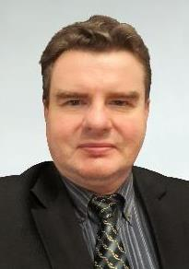
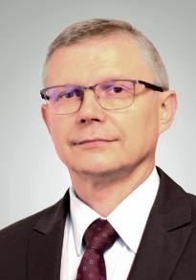
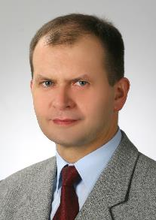
THE FACULTY OF ENVIRONMENTAL ENGINEERING AND GEODESY
FACULTY AUTHORITIES
DEAN
prof. dr hab. inż. Bernard Kontny
dr hab. inż. Robert Głowski Vice-Dean for: Bioeconomy, Environmental Engineering, Water Engineering and Management | dr hab. inż. Piotr Gołuch Vice-Dean for: Civil Engineering, Geodesy and Cartography | dr hab. inż. Tomasz Tymiński Vice-Dean for: Safety Engineering

Slide 11

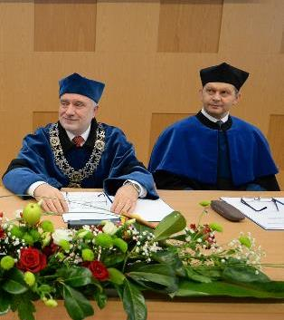
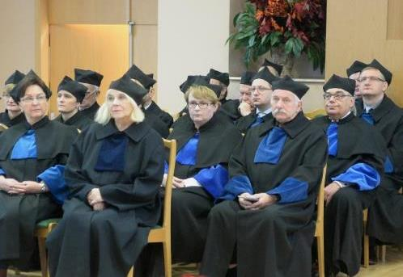
THE FACULTY OF ENVIRONMENTAL ENGINEERING AND GEODESY
FACULTY STAFF
- 114 academic teachers,
- 31 engineering and technical employees
- 13 administrative
Research is conducted two leading disciplines:
- civil engineering
geodesy and transport

Slide 12
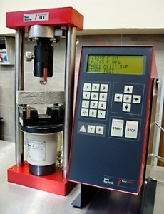
THE FACULTY OF ENVIRONMENTAL ENGINEERING AND GEODESY
FACULTY STRUCTURE

Slide 13

THE FACULTY OF ENVIRONMENTAL ENGINEERING AND GEODESY
STRATEGIC RESEARCH DIRECTIONS

Slide 14
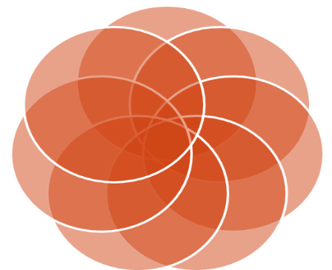
THE FACULTY OF ENVIRONMENTAL ENGINEERING AND GEODESY
FACULTY STRUCTURE
Institute
of Environmental Engineering
Institute
of Geodesy and Geoinformatics
Department
of Applied Mathematics
Department
of Civil Engineering
Department
of Environmental Protection and Development

Slide 15

THE FACULTY OF ENVIRONMENTAL ENGINEERING AND GEODESY
INSTITUTE OF ENVIRONMENTAL
ENGINEERING
Grunwaldzki Sq. 24, 50-363 Wrocław, phone +48 71 320 5579
e-mail: iis@upwr.edu.pl
DIRECTOR dr hab. Krzysztof Lejcuś
VICE DIRECTOR dr hab. inż. Katarzyna Pawęska
STRUCTURE
Division of Hydrology and Water Management
Division of Infrastructure and Sanitary Technology
Division of Hydrodynamic Modelling
Division of Groundwater and Waste Management
Laboratory of Soil Studies
Water Laboratory

Slide 16

THE FACULTY OF ENVIRONMENTAL ENGINEERING AND GEODESY
INSTITUTE OF GEODESY
AND GEOINFORMATICS
Grunwaldzka St. 53, 50-357 Wrocław, phone +48 71 320 5617
e-mail: igig@upwr.edu.pl
www.igig.up.wroc.pl
  DIRECTOR prof. dr hab. inż. Witold Rohm
VICE DIRECTOR dr hab. inż. Tomasz Hadaś
STRUCTURE
Division of Detailed Measurements and Engineering Geodesy
Division of Geodesy
Division of Geoinformatics
Division of Photogrammetry and Remote Sensing
GISLAB
Laboratory of Geodetic Technologies
Station for Permanent Observation GNSS ”WROC”

Slide 17
THE FACULTY OF ENVIRONMENTAL ENGINEERING AND GEODESY
DEPARTMENT OF APPLIED MATHEMATICS
Grunwaldzka St. 53, 50-357 Wrocław, phone +48 71 320 5615, e-mail: kzm@upwr.edu.pl
MANAGER
dr hab. inż. Joanna Kamińska, profesor uczelni
STRUCTURE
Division of Scientific Research
Division of Didactics

Slide 18

THE FACULTY OF ENVIRONMENTAL ENGINEERING AND GEODESY
DEPARTMENT OF CIVIL ENGINEERING
Grunwaldzki Sq. 24, 50-363 Wrocław, phone +48 71 320 5526
e-mail: sekretariat.ibr@upwr.edu.pl https://wiksig.upwr.edu.pl/wydzial/struktura/katedra-budownictwa
MANAGER
dr hab. inż. Jolanta Dąbrowska
STRUCTURE
Design studio of Building Engineering
Design studio of Building Structures
Division of Geotechnics
Division of Mechanics and Strength of Materials
Geotechnical Laboratory
Technology Laboratory of Building Materials and Structures

Slide 19

THE FACULTY OF ENVIRONMENTAL ENGINEERING AND GEODESY
DEPARTMENT OF ENVIRONMENTAL PROTECTION AND DEVELOPMENT Grunwaldzki Sq. 24, 50-363 Wrocław, phone 48+71 320 5585, e-mail: sekretariat.kkios@upwr.edu.pl
MANAGER dr hab. inż. Tomasz Kowalczyk, prof. uczelni STRUCTURE Division of Environmental Development and Water Management Systems Exploatation Division of Irrigation and Hydrometeorology Division of Safety Engineering Laboratory for Environmental Processes Modelling and Ergonomy

Slide 20
THE FACULTY OF ENVIRONMENTAL ENGINEERING AND GEODESY
STRATEGIC RESEARCH DIRECTIONS

Slide 21
THE FACULTY OF ENVIRONMENTAL ENGINEERING AND GEODESY
STRATEGIC RESEARCH DIRECTIONS

Slide 22
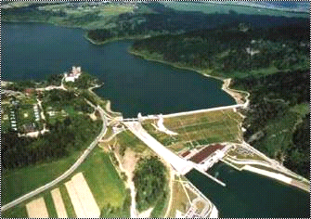
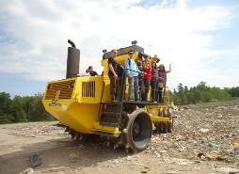
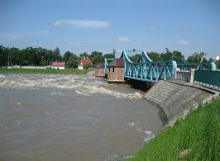
THE FACULTY OF ENVIRONMENTAL ENGINEERING AND GEODESY
INSTITUTE OF ENVIRONMENTAL ENGINEERING
modeling of hydrological and hydraulic processes (water flow
in watercourses, sediment transport and hydrodynamic impact
of vegetation, groundwater and pollution flow, hydrological
cycle processes)
restoration of rivers and pro-ecological river engineering;
water circulation processes in the soil-plant-atmosphere system and shaping the quality of the environment
shaping the quantity and quality of water resources and their optimal use, water quality in retention reservoirs
wastewater treatment in conventional and semi-natural systems, the use of biopreparations, assessment of the suitability of waste-water for reuse
electrochemical detection of pollutants, purification of industrial wastewater from heavy metals by sorption, use of natural materials for sorption of metals from wastewater.
environmental pollution with micro- and nanoplastics

Slide 23
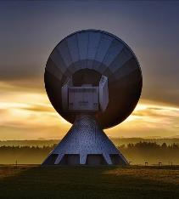
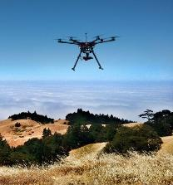
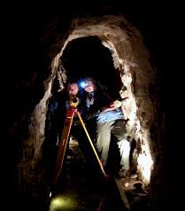
THE FACULTY OF ENVIRONMENTAL ENGINEERING AND GEODESY
INSTITUTE OF GEODESY AND GEOINFORMATICS
development of new processing methodologies for GNSS troposphere observations (ground-based, space-based and reflected)
finding innovative applications for GNSS observations in atmosphere studies
developing new processing strategies for satellite radar data processing in anthropogenic deformation zones
development of new methods to integrate geodetic observations: ground-based and space-based; microwave, laser, radar and gravimetric, point- and area- based, episodic and continuous
advancing of satellite laser ranging processing within the International Laser Ranging Service
advancing of GNSS data processing within E-GVAP initiative
application of geodetic technique to analyze the frost heave soils
development of Machine Learning methods for remote sensing and satellite geodesy and their application

Slide 24

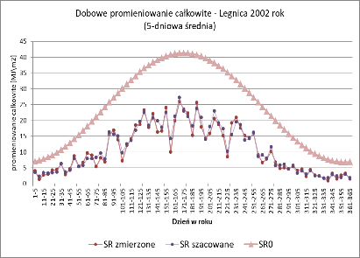
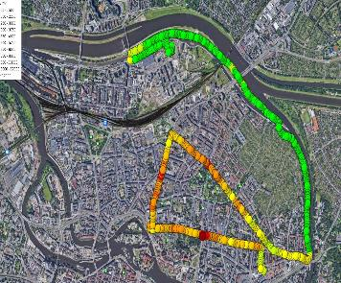
THE FACULTY OF ENVIRONMENTAL ENGINEERING AND GEODESY
DEPARTMENT OF APPLIED MATHEMATICS
research and modeling of air quality in urban agglomerations
Riemann spaces satisfying Einstein-type curvature conditions
estimation of daily total radiation
cooperation within the Lower Silesian Water Partnership
cooperation in the field of statistical analysis of various data

Slide 25
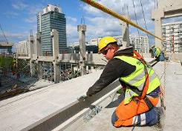
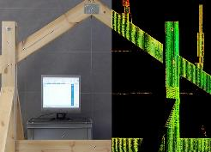
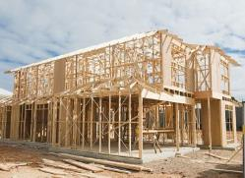
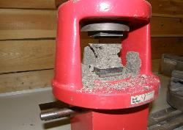
THE FACULTY OF ENVIRONMENTAL ENGINEERING AND GEODESY
DEPARTMENT OF CIVIL ENGINEERING
the influence of climate change on soil parameters
the effect of micro and nano additives on selected properties of fine
-grained soils
dynamic analysis of beams and plates subjected to moving loads
determination of soil deformation parameters based on laboratory tests
investigations in the range of small deformation using seismic waves
experimental and theoretical studies of deformations bending elements
made of high-strength concrete modified with steel fiber and longitudinal
reinforcement
the temperature effect on properties of cement composites and derived materials. Application of the electrical measurements in the testing
of cement composites
rheological models of lime paste and effect of lime on rheological
properties of mixed cement-lime and gypsum-lime pastes
resilience of the built environment to climate change
new methodology for determining the load capacity of hybrid
riveted-bolted connections in steel bridge structures
Mechanics and reliability of wooden built-up girders

Slide 26
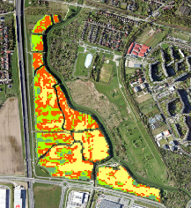
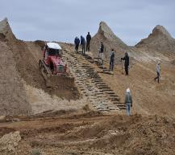
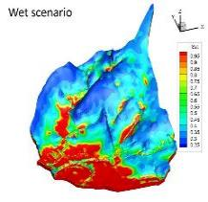
THE FACULTY OF ENVIRONMENTAL ENGINEERING AND GEODESY
DEPARTMENT OF ENVIRONMENTAL PROTECTION
AND DEVELOPMENT
Planning and management of blue-green infrastructure in adapting urban areas to climate change.
Evaluation and analysis of the acoustic climate.
Measurements and quantitative and qualitative assessment of surface waters.
Monitoring and analysis of environmental water resources.
Resource assessment and landscape retention planning.
Evaluation of work safety in the area of environmental infrastructure.
Work ergonomics in industry.
Occupational risk assessment for services removing the effects of fires in illegal waste storage sites.
Climate and bioclimate analysis using linear and non-linear statistical methods.
Numerical modeling of the flow of surface and ground waters, taking into account pollutants of agricultural origin.
Research on leachate treatment from municipal waste landfills.
Analyzes of physicochemical properties and toxicity of landfill leachate.
Research on the bioaccumulation and translocation of selected pollutants
from leachates and on various types of fillings.
Remote sensing of the environment in terms of the effects of climate change.
Remote sensing and photogrammetry in the aspect of rainwater management and urban greenery.

Slide 27
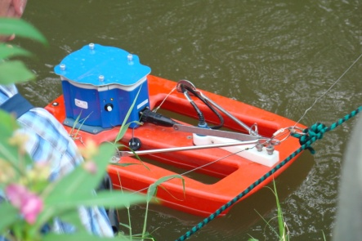
THE FACULTY OF ENVIRONMENTAL ENGINEERING AND GEODESY
EDUCATIONAL SYSTEM

Slide 28
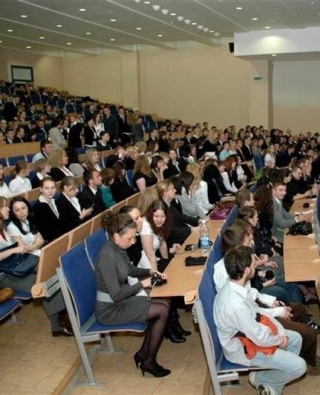
THE FACULTY OF ENVIRONMENTAL ENGINEERING AND GEODESY
WE EDUCATE STUDENTS
in 7 FIELDS OF STUDY:
since 1951
since 1962
since 1972
since 2009
since 2011
since 2022
since 2024
Environmental Engineering
Geodesy and Cartography
Civil Engineering
Safety Engineering
Water Engineering and Management
Bioeconomy ( only in English )
Adaptations to Microclimate Changes

Slide 29

THE FACULTY OF ENVIRONMENTAL ENGINEERING AND GEODESY
STUDENTS OF THE FACULTY
(31.12.2023)
Fields of study | Full-time | Part-time | Total
Bioeconomy | 50 | - | 50
Civil Engineering | 283 | 236 | 519
Environmental Engineering | 270 | - | 270
Geodesy and Cartography | 102 | - | 102
Water Engineering and Management | 28 | - | 28
Safety Engineering | 193 | - | 193
Total | 926 | 236 | 1162

Slide 30
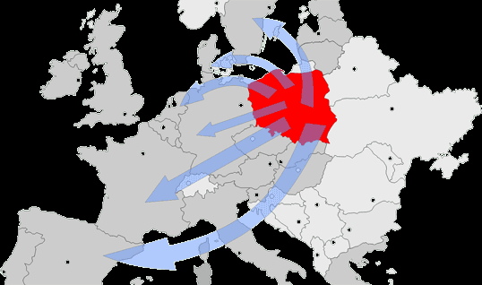
THE FACULTY OF ENVIRONMENTAL ENGINEERING AND GEODESY
INTERNATIONAL COOPERATION
Latvia University of Agriculture in Jelgava (Latvia),
Changsha Research Institute of Mining and Metallurgy in Changsha, Hunan (China)
University of Rostock (Germany),
Hunan Agricultural University, Hunan Provice, Changsha (China),
Onsekiz Mart University in Kanakkale (Turkey),
Slovak University of Agriculture in Nitra (Slovakia),
Brno University of Technology (Czech Republic),
Minzu Univrsity, Beijing (China),
University of Florida in Gainesville (USA),
University of Hawaii at Manoa (USA).
Technical University in Zurich
Norwegian University of Agriculture in As.
Kyiv State Civil Engineering and Architecture University (Ukraine)
Humboldt University in Berlin (Germany),
Slovak University of Agriculture in Nitra
Dresden University of Technology (Germany)
Kanakkale Onsekiz Mart University (Turkey).
University of Camerino (Italy)
National Seismologic Observatory in Athens (Greece)
also universities in Rostock, Dresden, Hannover, Köln, Munich, Wageningen,
Prague, Brno, Nitra,Oslo, Delft

Slide 31
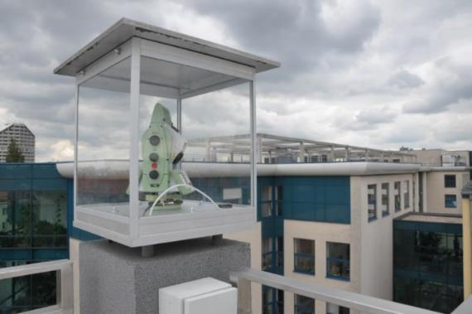
THE FACULTY OF ENVIRONMENTAL ENGINEERING AND GEODESY
SCIENTIFIC
AND
DIDACTIC BASE

Slide 32
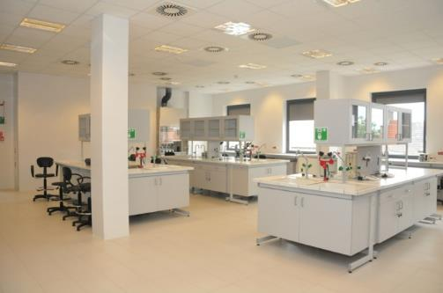
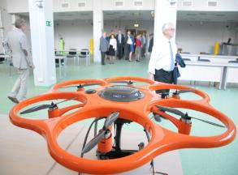


THE FACULTY OF ENVIRONMENTAL ENGINEERING AND GEODESY
GEO-INFO-HYDRO CENTRE
Project co-financed by the European Union

Slide 33




THE FACULTY OF ENVIRONMENTAL ENGINEERING AND GEODESY
LECTURE HALLS
COMPUTER ROOMS

Slide 34





THE FACULTY OF ENVIRONMENTAL ENGINEERING AND GEODESY
LABORATORIES:
Geotechnical
GIS-Lab
Multisensory surveying technologies
Materials technology
and building structures
Soil physics
and modelling environmental processes
Water and wastewater technology
Water

Slide 35



PAWŁOWICE PALACE
Education Centre

Slide 36



THE FACULTY OF ENVIRONMENTAL ENGINEERING AND GEODESY
COMPUTER AND SOCIAL ROOMS FOR STUDENTS

Slide 37








THE FACULTY OF ENVIRONMENTAL ENGINEERING AND GEODESY
STUDENT SCIENTIFIC CLUBS
Civil Engineering ”Wspornik”
Geodesy
Hydrologist and Hydrotechnicians
Safety Engineering ”Bezpiecznik ”

Slide 38

THE FACULTY OF ENVIRONMENTAL ENGINEERING AND GEODESY
STUDENT PROJECTS

Slide 39





THE FACULTY OF ENVIRONMENTAL ENGINEERING AND GEODESY

Slide 40



THE FACULTY OF ENVIRONMENTAL ENGINEERING AND GEODESY

Slide 41



THE FACULTY OF ENVIRONMENTAL ENGINEERING AND GEODESY

Slide 42



THE FACULTY OF ENVIRONMENTAL ENGINEERING AND GEODESY
INTERNATIONAL STUDENTS EXCHANGE
We host young people as part of the international Erasmus+ and Cepus programs, national scholarships and a scholarship from our University and also foreigners with the Pole's Card.
The number of foreign students studying at our faculty before the Covid pandemic was gradually increasing: from 28 people in 2010 to 78 people in 2019.
After a break due to the pandemic, 41 students came to us in 2022.
Most students come to us from France, Spain, Germany, Norway, Turkey, Ukraine and Italy, but also from other countries such as: Azerbaijan, Belgium, Belarus, Croatia, the Czech Republic, Greece, Lithuania, Latvia, the Netherlands, Portugal and Romania.
.

Slide 43




STEP UP - Support Team for Exchange Programs
We are a group of eager enthusiasts to help foreign students coming to our university. We learn, work and play together.
STEP UP President Wiktoria Szewiore
e-mail: step.upwr@gmail.com

Slide 44

UNIVERSITY SOCIAL BASE
AND
LEISURE ACTIVITIES

Slide 45
CAMPUS MAPS
Distance between campuses - 4 km
(you can take tram, bus or city bike)

Slide 46




CAMPUS
”PLAC GRUNWALDZKI”

Slide 47




CAMPUS ”BISKUPIN”

Slide 48






DORMITORIES
Wrocław University of Environmental and Life Sciences has over 1,300 places in six dormitories. Individual dormitories have rooms of various sizes: from triple, double and single rooms to modular rooms with their own bathroom and kitchen. Each of the rooms has access to the Internet and an intercom connecting with the 24-hour reception.

Slide 49





UNIVERSITY
SPORT CENTER

Slide 50






UNIVERSITY SPORT CLUBS

Slide 51




THE STUDENTS’ SELF-GOVERNMENT AND STUDENT ORGANISATIONS:
University Sports Association
Student Photo Agency
Dance Club „Up”
Folk Dance Group „Jedliniok”
Student Choir and Orchestra
University Tourist Club

Slide 52




THE FACULTY OF ENVIRONMENTAL ENGINEERING AND GEODESY
OFFICIALLY
&
JOYFULLY

